Slide 1
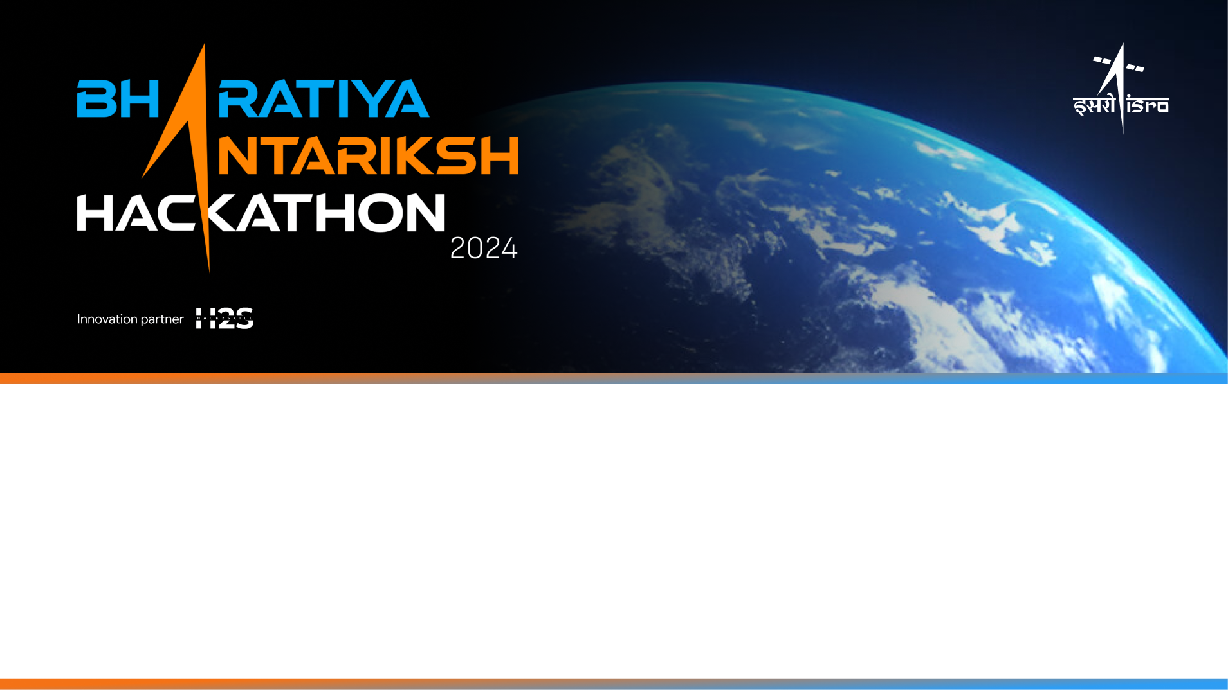
Team Name: LunaTechs
Name of College(s)/University(s): Shiv Nadar University, Chennai
Team Members Details:
Kayalvizhi S
Hridya Shree R
N V S Keerthana Lingamallu

Slide 2
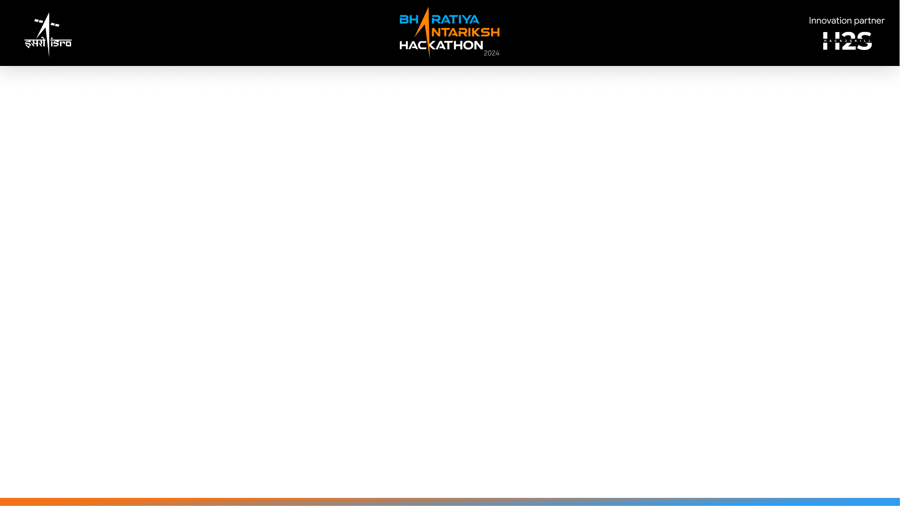
Detailed solution and Approach (250-300 words)
Data Preprocessing
1. Image Acquisition and Preparation: Obtain the LRO WAC global mosaic and Chandrayaan-2 TMC nadir images. Perform normalization, noise reduction, and resolution adjustment to ensure compatibility between datasets.
2. Contrast Enhancement: Enhance image contrast to highlight subtle features. Apply Gaussian and median filtering to reduce noise and correct geometric distortions using affine and perspective transformations. Formal statistical approaches are to be used.
Crater Detection Using Deep Learning
1. Model Implementation: Employ a U-Net-based convolutional neural network with ResNet18 as the backbone. Pre-trained on ImageNet, this model will be further fine-tuned on annotated lunar crater datasets for improved accuracy.
2. Multi-Scale Feature Extraction: The U-Net model extracts features at various scales to detect craters of different sizes and complexities.
Crater Segmentation
1. Instance Segmentation: Refine crater detection results using Mask R-CNN to ensure precise segmentation and boundary definition.
2. Post-Processing: Remove false positives and enhance segmentation results.
Spatial Resolution Handling
1. Resolution Adjustment: Develop algorithms (like the bicubic interpolation, Gaussian blurring or super-resolution techniques to be chosen based on accuracy) to handle resolution differences between Chandrayaan-2 TMC (5m) and LRO WAC (100m) images, using downscaling or upscaling techniques.

Slide 3
Detailed solution and Approach (250-300 words)
Template Matching and Location Extraction
1. Advanced Techniques: Utilize wavelet and Hough transforms for enhanced feature detection. Implement correlation-based methods to match crater templates with the global mosaic and extract precise coordinates.
Morphological Analysis and CSFD Calculation
1. Feature Extraction: Measure crater attributes such as diameter and depth. Calculate Crater Size Frequency Distribution (CSFD) to estimate surface ages and analyze crater density.
Software Development
Interface Creation: A user-friendly software interface for data input, processing, and visualization of crater locations and attributes for which ArcGIS and its complementary tools is to be used. GDAL is planned to be used to handle images and perform coordinate transformations.
Crater Catalog Matching
1. Feature-Based Matching: Compare crater features with a lunar catalog using feature-based matching and nearest neighbor search algorithms.
2. Metadata Integration: Integrate matched data for detailed crater insights and relationships.
This comprehensive approach ensures accurate detection, segmentation, and analysis of lunar craters, supported by advanced image processing and deep learning techniques.

Slide 4
Tools and Technology Used (50 words)
Our solution leverages a robust blend of tools and technologies to achieve exceptional accuracy and efficiency. At its core is a powerful Python-based environment, optimized by integrating:
Deep Learning Frameworks: TensorFlow/Keras, PyTorch
- TensorFlow/Keras supports rapid prototyping and model training, while PyTorch offers advanced optimization and flexibility.
- These frameworks implement the U-Net model for crater detection and Mask R-CNN for instance segmentation, providing efficient GPU acceleration and extensive tools for model development.
Computer Vision Libraries: OpenCV, Scikit-image, Albumentations
- OpenCV is used for real-time image processing, feature extraction, and geometric transformations.
- Scikit-image handles tasks like contrast enhancement, noise reduction, and geometric correction.
- Albumentations is employed for robust data augmentation.
Geospatial Data Handling: GDAL, GeoPandas
- GDAL manages lunar Digital Elevation Model (DEM) data, facilitating integration with deep learning models.
- GeoPandas is used for spatial data analysis and coordinate transformation.
Explainable AI (XAI)
- Libraries like SHAP or LIME help interpret model predictions, enhancing transparency and reliability.
For Software Development & Visualization:
- ArcGIS : For geospatial data analysis, interactive map creation, and visualization.
- Python with ArcPy, OpenCV, and GDAL: For automating mapping tasks, image processing, and handling geospatial data.
- Additionally Django/HTML/CSS/JS maybe used to create the interface

Slide 5
Opportunity should be able to explain the following: Unique aspects and solution effectiveness
Our solution revolutionizes lunar crater analysis by integrating deep learning and image processing in a unique and comprehensive manner. Unlike existing methods that focus solely on 2D crater detection, we incorporate multi-spectral image fusion and crater evolution modeling, providing an unmatched holistic framework.
Key differentiators include the integration of multi-spectral data, which enables detailed extraction of crater composition, mineralogy, and thermal properties. Additionally, our crater evolution modeling offers insights into the geological history of the lunar surface and identifies regions of interest for further exploration.
The unique selling points of our solution are:
Detailed extraction of crater composition and morphology.
Guidance for future lunar exploration and resource utilization.
A comprehensive framework offering extensive information for understanding the lunar surface.
By addressing the limitations of existing approaches and providing a data-driven, comprehensive solution, our lunar crater analysis framework significantly advances planetary science and exploration.

Slide 6
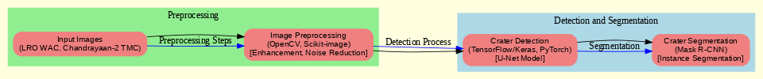

Proposed architecture/user diagram

Slide 7
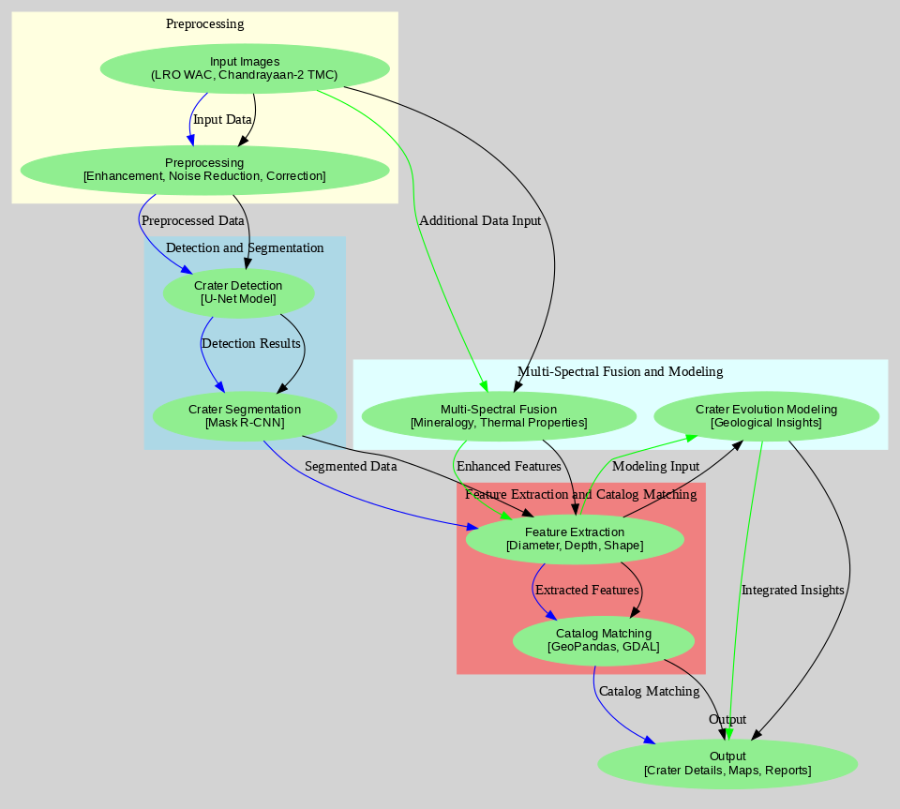

Slide 8
List of features offered by the solution
Automated Crater Detection and Segmentation:
- Utilizes deep learning models like U-Net and Mask R-CNN for efficient detection and segmentation of craters of varying sizes and complexities.
- Employs multi-scale feature extraction to capture crater details at different resolutions.
Accurate Crater Measurement and Characterization:
- Computes precise geometric measurements such as diameter, depth, area, and volume.
- Extracts morphological features like circularity and ellipticity, and generates 3D models for enhanced analysis.
Integration with Lunar Crater Databases:
- Matches detected craters with existing lunar crater catalogs for additional metadata and validation.
- Enhances the reliability of results by cross-referencing with known features.
Customizable Detection Parameters:
- Allows users to adjust detection sensitivity and set size thresholds for targeted analysis.
- Optimizes parameters for different regions or datasets for adaptability.
Visualization Tools for Analysis and Validation:
- Provides interactive tools for exploring detected craters and generating reports.
- Enables overlaying detected craters on lunar images for performance evaluation and comparison with ground truth data.

Slide 9
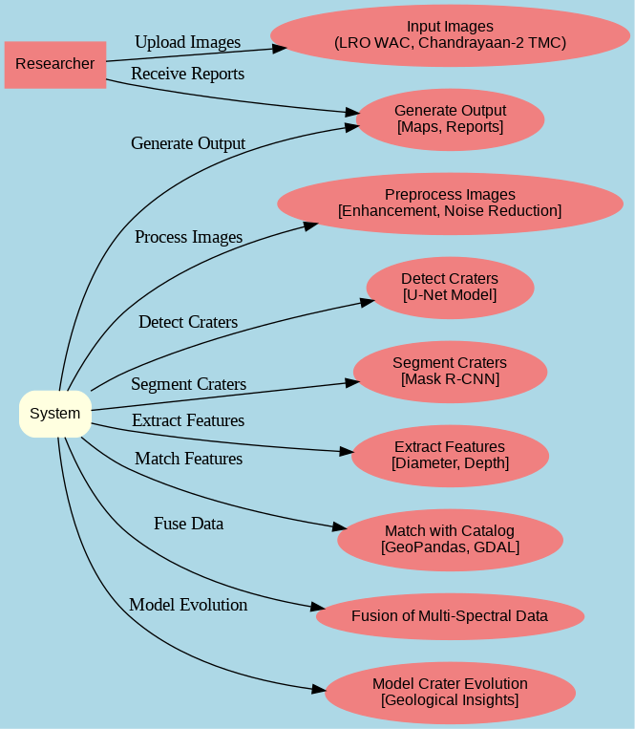
Process flow diagram or Use-case diagram

Slide 10
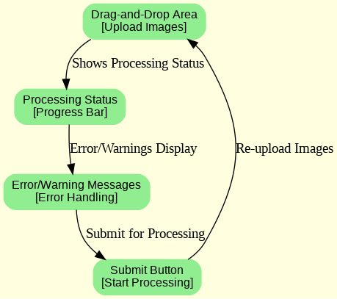
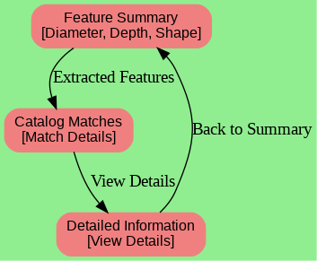
Wireframes/Mock diagrams of the proposed solution (optional)
1. Dashboard Overview
3. Crater Detection Results
4. Crater Feature Analysis
2. Image Upload and Processing

Slide 11
Solution Brief (Overall)
Our lunar crater detection solution combines advanced deep learning and image processing techniques to offer a comprehensive framework for analysing lunar craters. Utilizing models like U-Net and Mask R-CNN, the system automates crater detection and segmentation with high accuracy, accommodating various sizes and complexities. Key features include precise geometric measurements and detailed morphological analysis, enhancing our understanding of crater formation and evolution.
The solution integrates with existing lunar crater databases for effective validation and cross-referencing, enriching datasets with new findings. Customizable detection parameters and size thresholds allow adaptability to different research needs and datasets. Interactive visualization tools enable researchers to explore and validate detected craters, facilitating analysis and insight generation.
Overall, this approach addresses the shortcomings of traditional methods, providing crucial insights into lunar geology, resource potential, and impact history, thereby propelling advancements in planetary science and exploration.

Slide 12
